Slide 1
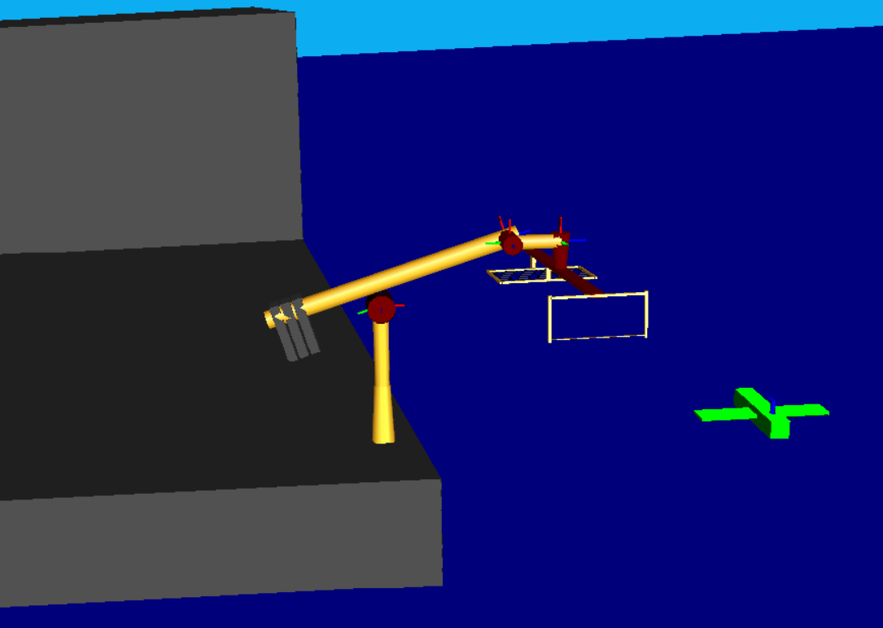
Drone Recovery Robot
Matt Kennedy
John Furumo
Snapshot of Robot Model
from RoboWorks

Slide 2
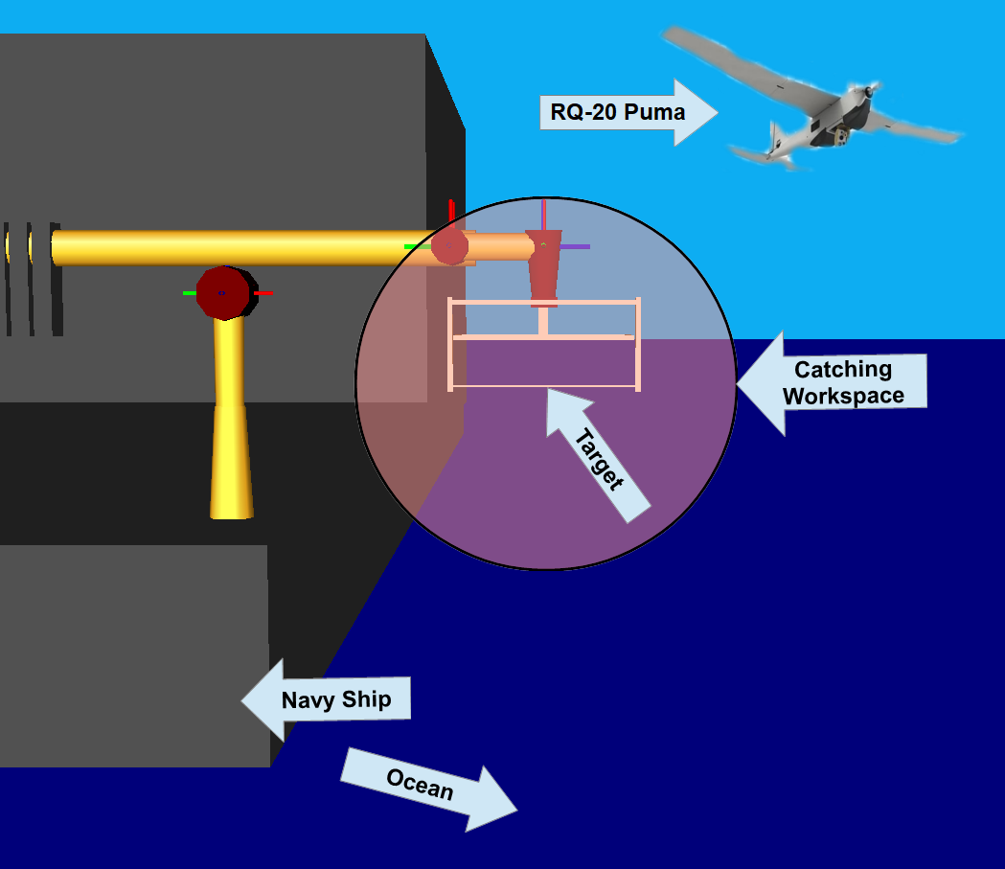
Robotic Task (Description)
9-DEC-2019
2
ENAE692/Robot Project
Notes:
2

Slide 3
Robotic Task (Requirements)
Kinematic Requirements
Have a large horizontal and vertical reach
Be able to track a target in space with quickly changing conditions (wave motion, flight controls)
Workspace Requirements
Reach into safe flight path away from ship
Match orientation of drone
Force Requirements
Impact with 6kg drone moving at ~40km/h
Other
Return drone to ship deck
Stow arm safely on-board ship
9-DEC-2019
3
ENAE692/Robot Project

Slide 4
Robot Design (Specifications)
Description | Specification
Total Degrees of Freedom | 7
Arm Type* | DYPDPRY
Wrist Type† | PRY (IAW-No)
Redundancy | elbow orbit angle
Length Sum (L) | 10.4 m
Structural Length Index (Q) | 0.62
*R=roll, P=pitch, Y=yaw, D=prismatic
†IAW-intersecting axis wrist

Slide 5
Robot Design (Link Frames)
Θ₂
d4
x4
Top View
z1, z2, x3
x1,x2
z4
a4
Θ₇
x5
z7
z6
Θ₃
z3
Θ₅
Θ₆
z5
x6,x7
z7
z1, z2, x3
x4,x5
d4
Θ₅
Θ₇
Side View
Θ₃
x1,x2
z4
z6
a3
z5
x6,x7
z3
Θ₆
Θ₂
tern device
d1
z0
θ_{ΗΟΜΕ}=[2.5m, 0 rad, π/2 rad, 2.5m, 0, 0, 0]^{T}
x0

Slide 6
Robot Design (D-H Table)
i | α_{i-1} (deg) | a_{i-1} (m) | d_{i} (m) | θ_{i} (deg) | JL⁻ (deg) | JL⁺ (deg)
1 | 0 | 0 | d1 | 0 | 2.5m | 3.75m
2 | 0 | 0 | 0 | Θ₂ | -180 | 180
3 | 90 | 0 | 0 | Θ₃ | 45 | 135
4 | 90 | 0.4m | d4 | 0 | 2.5m | 3.75m
5 | -90 | 0.75m | 0 | Θ₅ | -45 | 45
6 | 90 | 0 | 0 | Θ₆ | -22.5 | 22.5
7 | 90 | 0 | 0 | Θ₇ | -45 | 225
JL = JOINT LIMIT

Slide 7
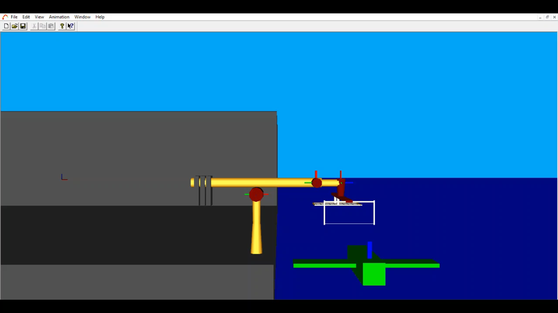
Robot Design (Joint Animation)
My Awesome Robot
(Show the motion of each joint in RoboWorks)

Slide 8
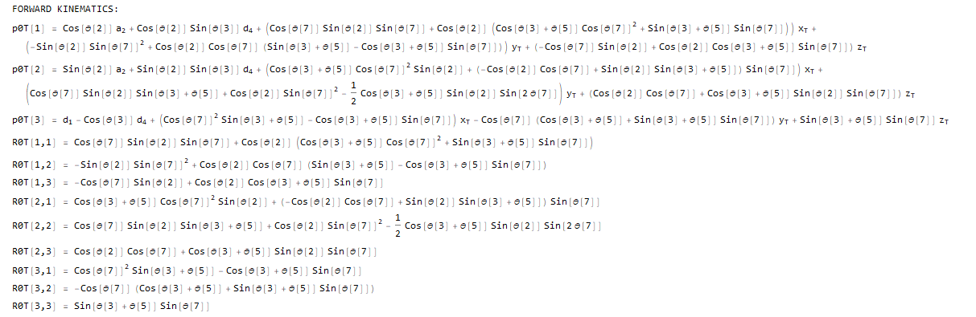
Forward Kinematics
9-DEC-2019
8
ENAE692/Robot Project

Slide 9
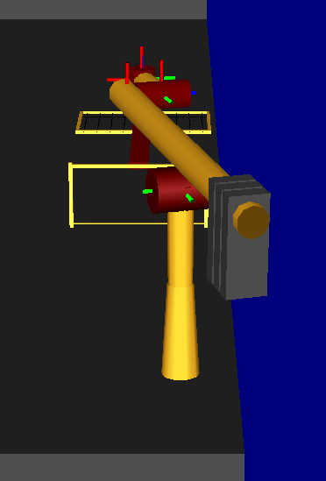
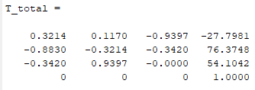
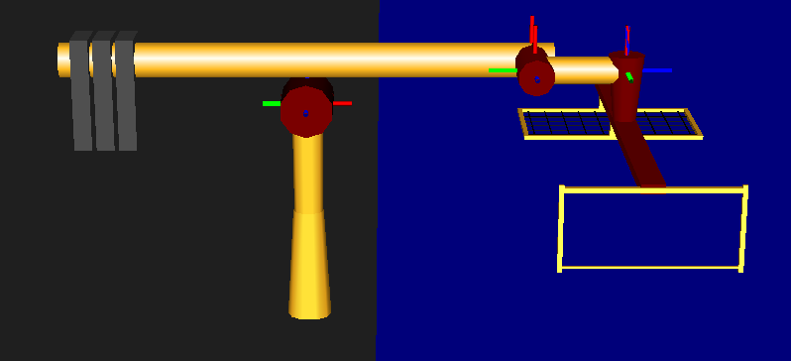
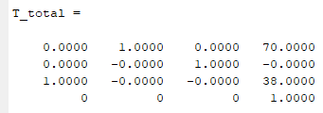
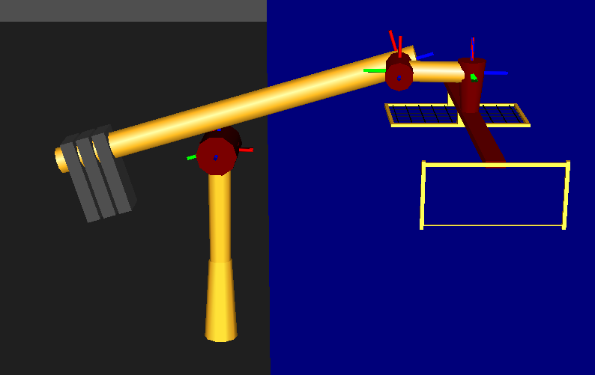
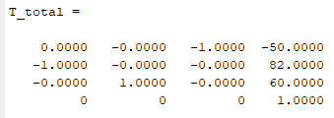
Forward Kinematics (Test)
q = [50,1.92,1.57,50,0,0,-1.92]
p0T=
R0T=
q = [50,0,1.57,50,0,0,0]
p0T=
R0T=
q = [50.8,1.57,1.75,50.85,-0.18,0,-1.57]
p0T=
R0T=
snapshot
9-DEC-2019
9
ENAE692/Robot Project
Notes:
9

Slide 10
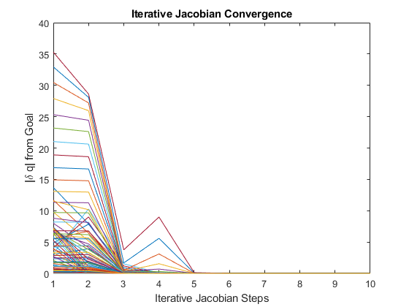
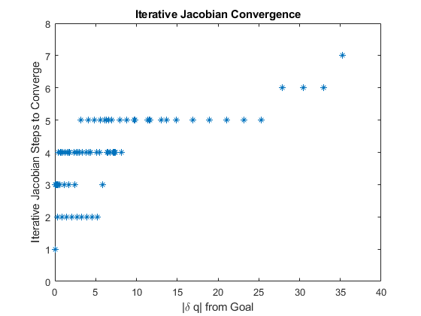
Inverse Kinematics (Solution)

Slide 11
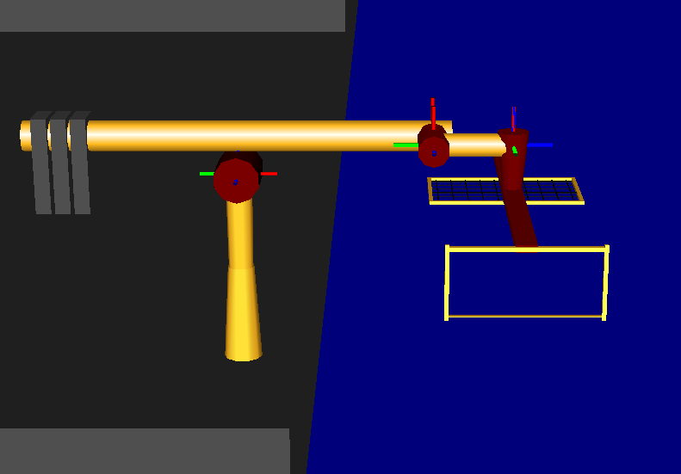
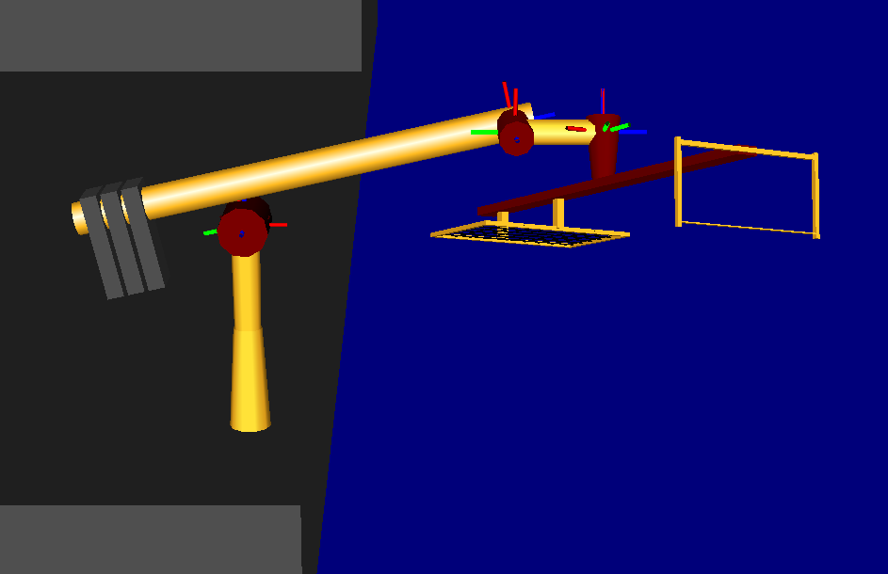
Inverse Kinematics (Test)
q_{START} = [50,0,pi/2,50,0,0,0]
⁰p_{GOAL}= [65,65,65],
⁰R_{GOAL}= [pi/8,-pi/8,0]=[yaw,pitch,roll]
show start configuration
Solution:
Q_{GOAL} = [50.84,0.32,2.09,72.63,-0.52,-0.39,0.077]
show end configuration
Solution Check:
⁰p_{T} (q_{GOAL}) = [65,65,65]
9-DEC-2019
11
ENAE692/Robot Project

Slide 12
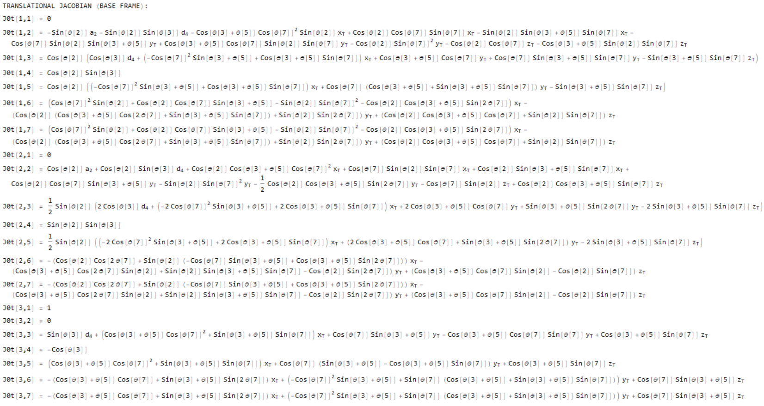
Translational Jacobian (Base Frame)

Slide 13
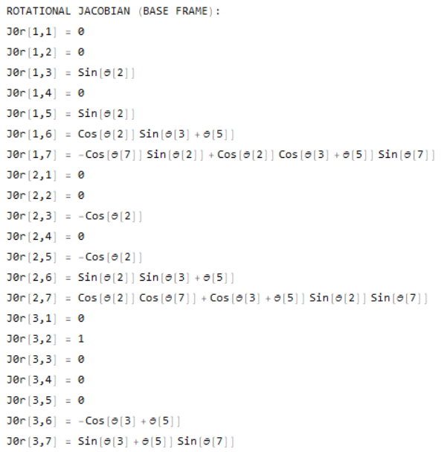
Rotational Jacobian (Base Frame)

Slide 14

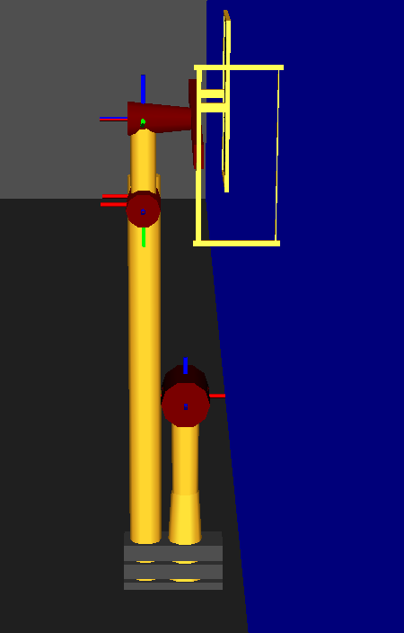
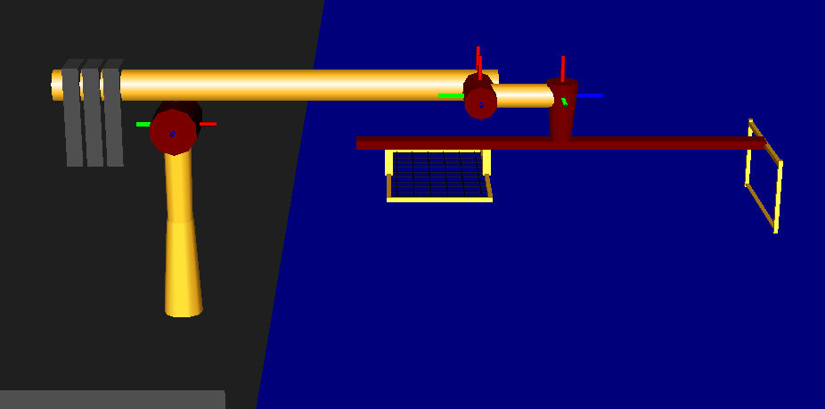
Singularities
Internal:
Boundary:
linearly dependent columns
9-DEC-2019
14
ENAE692/Robot Project

Slide 15
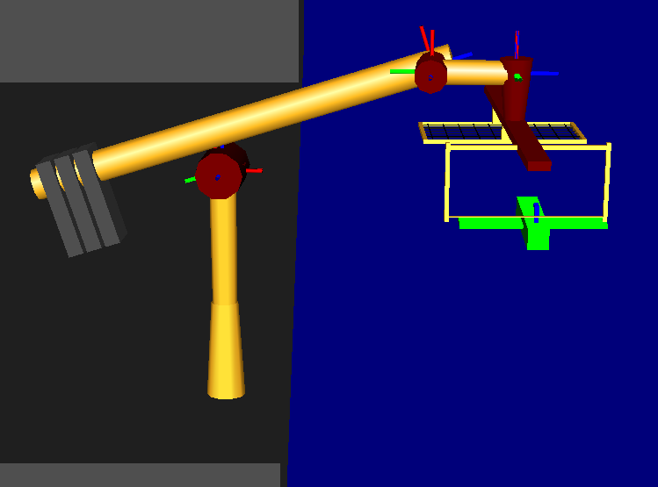
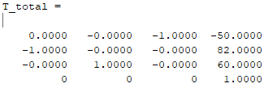
Maximum Load
Maximum Task Force/Torque:
F_{MAX} = [0, 300N, 0], N_{MAX} = [0,0,0]
Workspace Pose:
Joint Position:
q_{T}= [50.77,1.57,1.75,50.84,-0.18,0,-1.57]
Force
τ = J*F=[0,-15000,-6369,295,
-3600,15000,15000]
ϑ^{Τ}(θ)
(Joint Torques)
9-DEC-2019
15
ENAE692/Robot Project

Slide 16
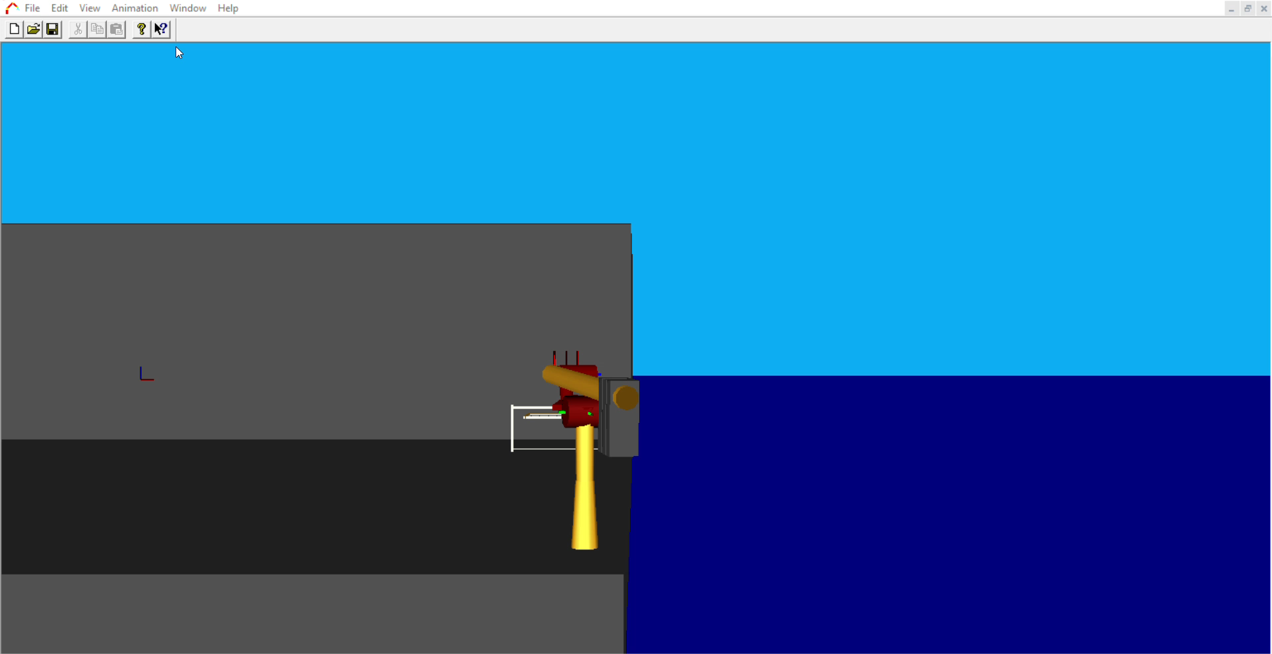
Task (Animation)
Task Animation
(Show task execution in RoboWorks)
*Note: required for teams of 2

Slide 17
Conclusions
Robot Design
The workspace is adequate for the task in question
Singularities do not provide a major obstacle to overcome
Kinematic Redundancy
Future Work
Add stabilization of boat motion to dynamics
Other applications – land use
What I Learned
More DoF not always advantageous
Difficult to model and visualize kinematics beyond minimal DoF

Slide 18
Back-up

Slide 19
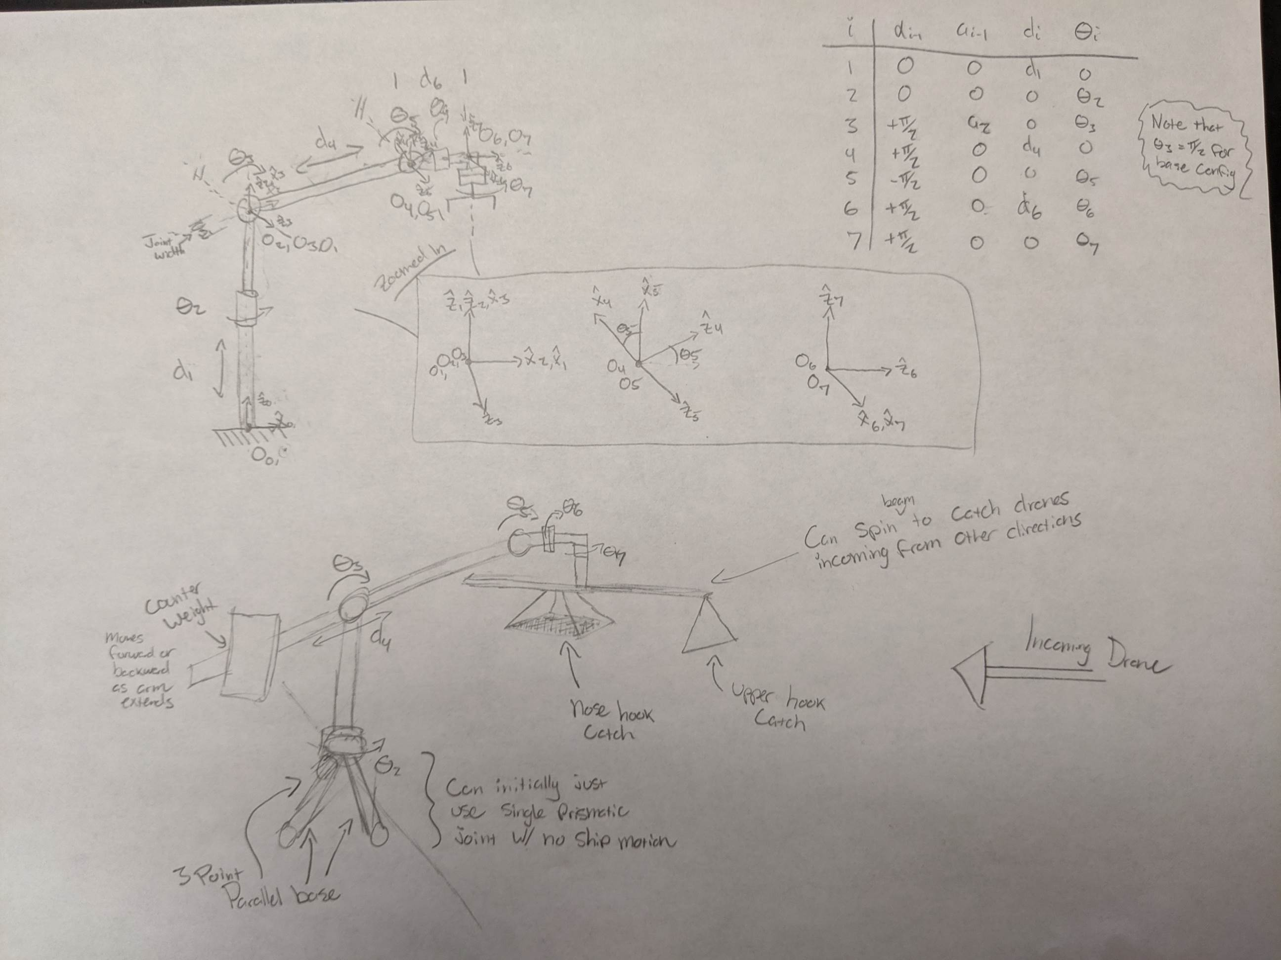

Slide 20
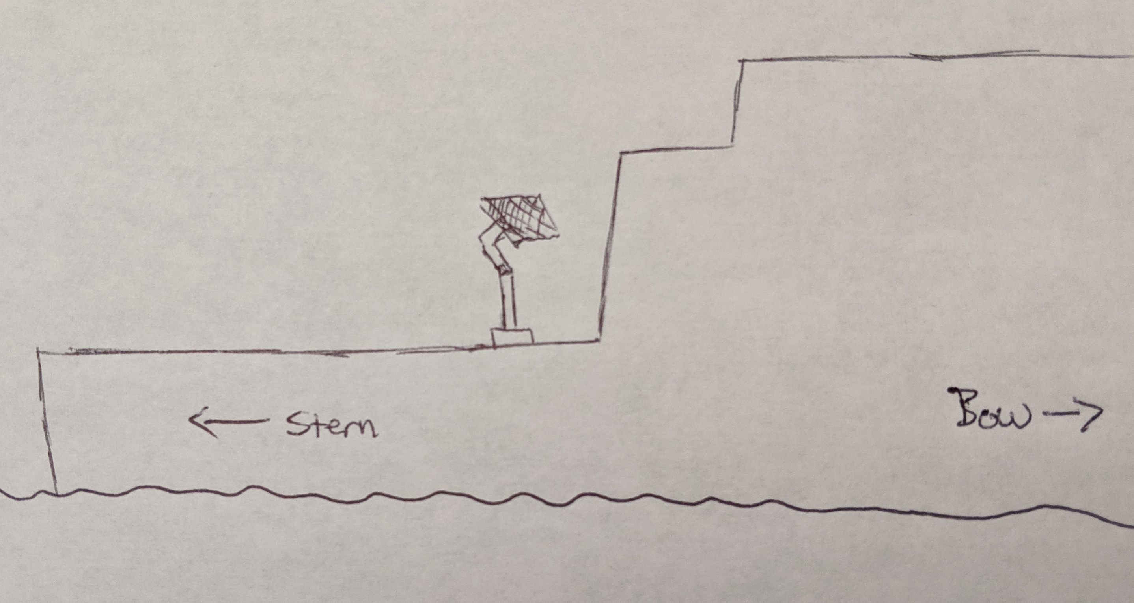
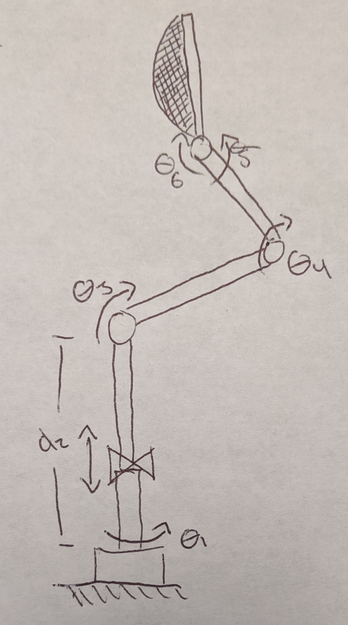
Drone Recovery Arm
Team: Matt Kennedy
John Furumo
Objective:
Design a manipulator capable of safely recovering both fixed wing and rotary drones to an underway ship.
Motivation:
• Facilitate drone recovery in all weather
• Facilitate drone recovery to all ship types
Task Requirements:
Kinematics
3 DOF to orient the catching mechanism
3 DOF to adjust height and stabilize tool tip
Workspace
Orient catching mechanism to 1m (width) by 2m (height) target area
Lower catching mechanism to ground for drone removal
Force/Moment
Impact with 40kg drone moving 10m/s (for fixed wing)
Drone Recovery Arm mounted to LCS Flight Deck
Robot Design:
Initial concept uses 5 revolute joints for positioning and orientation, and a prismatic joint near the base for additional stabilization.
The estimated required arms lengths are:
D2 = 2-3m
L3 = 1m
L4 = 1m
Though design requirements will be further investigated for optimal workspace to ensure safe wave-offs. The end-effector catching mechanism is initially proposed to be a simple net, though the effectiveness of others will be investigated.
23-OCT-2019
Notes:
20

